Slide 1
THE CHOSEN
EPISODE ONE

Slide 2
KEY SCRIPTURE: ISAIAH 43
But now, thus says the Lord, who created you, O Jacob; who formed you, O Israel; Fear not, for I have redeemed you; I have called you by name: you are mine. When you pass through the waters, I will be with you; and through the rivers, you shall not drown; when you walk through fire you shall not be burned, and the flames shall not consume you. For I am the Lord your God, the Holy One of Israel, your Savior.

Slide 3
SACRMENTALITY / IMAGINATION / FILM AS PARABLE

Slide 4
IMAGINATION / SACRAMENTALITY
MOVIE AS PARABLE
Sacramental worldview - God loves us & constantly enters our world & our lives to be with us and to give us the gift of fullness of life. God’s presence can be found in all of creation and God communicates to us through it
Faith deeply rooted in imagination which provides access to deepest levels of truth - where we can encounter God
A parable gives us a brief glimpse into the mystery of the reign of God. Story about God and unexpected ways God cares for us. Movie is parable we contemplate – way for God to speak to us. What touches us? What is God saying to us?

Slide 5
THE FILM: FROM THE PRODUCERS
The Chosen is based on the true stories of the Gospels of Jesus Christ.
Some locations and timelines have been combined or condensed.
Backstories and some characters or dialogue have been added.
All biblical & historical context and any artistic imagination are designed to support the truth and intention of the Scriptures.

Slide 6
MEET THE BIBLICAL CHARACTERS

Slide 7
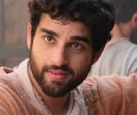
MATTHEW
Also known as Levi
Tax collector when Jesus called him to follow him
He left everything and followed Jesus – faithful disciple
Invited many friends and co-workers to meet Jesus
Wrote Gospel of Matthew

Slide 8
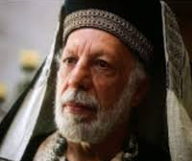
NICODEMUS
He is a Pharisee & member of Sanhedrin, supreme religious & political council in Jerusalem
Has an encounter with Jesus John 3:16
Among few men of influence to admit that Jesus came from God
Boldly assisted in preparation & burial of Jesus’ body.

Slide 9
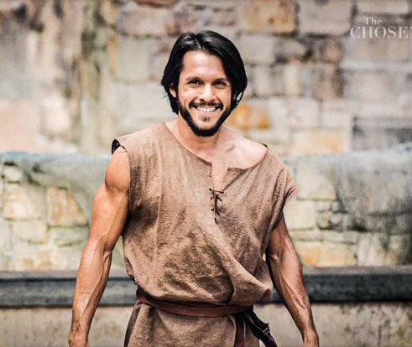
SIMON PETER
Fisherman known as Simon until Jesus renames Peter
Brought to Jesus by his brother Andrew
Follows Jesus after a miraculous catch of fish.
Known for walking on water, slicing off ear of soldier and denying Jesus.
Wrote 1 & 2 Peter

Slide 10
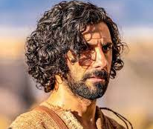
ANDREW
One of first to follow Jesus
Brought brother Peter to Jesus
Together with Peter, James & John, leaves everything & follows Jesus after miraculous catch of fish
Plays key role in feeding of 5000
Was disciple of John the Baptist before meeting Jesus

Slide 11
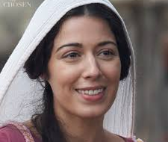
MARY MAGDALENE / LILITH / LIL
Cured by Jesus of 7 demons
Disciple of Jesus who travelled with him & supported his ministry.
Was at crucifixion & burial of Jesus
First witness of empty tomb, met risen Jesus
Sent by Jesus to tell other disciples

Slide 12
MARY MAGDALENE - PROSTITUTE
Some have identified her as the sinful woman in Luke 7: 36 – 39. Sinful woman / prostitute
This is how she is presented in The Chosen – she is found in the Red Quarter.
No evidence in scripture that this is true.
In 591 Pope Gregory first pronounced her a sinful woman / prostitute
In 1969 the church admitted they had mistakenly identified her as such.

Slide 13
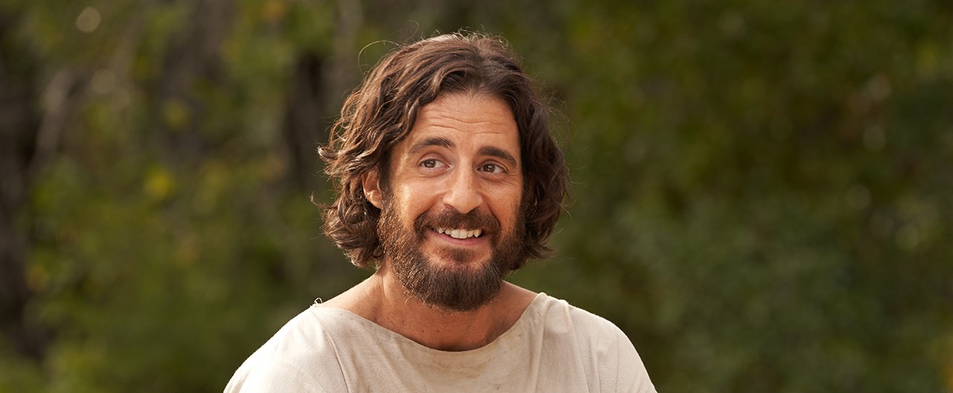
JESUS

Slide 14
OVERVIEW
EPISODE ONE

Slide 15
OVERVIEW EPISODE ONE
We are introduced to Mary Magdalene & a few disciples, getting to know who they are before they met Jesus. Little tied directly to gospels. Backstories.
Romans ask Nicodemus to perform an exorcism on woman in Red Quarter, it fails & he questions his faith
Brothers Peter & Andrew , fishermen, cannot pay taxes,
Simon lies to tax collector (Matthew) & says he is working for Roman praetor
Mary Magdalene, after failed suicide attempt, goes home to father, who is unable to help.
As she is leaving a pub, she encounters Jesus, who identifies himself as creator of humanity, calls her by name Mary of Magdala & reveals he knows who she is.

Slide 16
FOR FURTHER REFLECTION
Questions to ponder at home
Prayer points
Scripture to read, reflect on, pray with

Slide 17
NOTES FOR THE CONVERSATION
Sharing is optional. Each person shares on the level where they feel comfortable.
Listen respectfully and openly. There is no discussion or commenting on what is shared.
Participants are encouraged to share in the first person – I feel…
Participants are encouraged to wait to share a second time until others who wish to do so have spoken.
Anything shared in the group is confidential and does not leave the group. It is meant to be a gift for this group alone.

Slide 18
TABLE TALK
What character stood out most for you? Why? Which character did you identify with most?
What impacted you most in this episode and why?
What did you learn about Jesus from this episode? Was your impression or understanding of Jesus sharpened, challenged or changed?
Do you have a scripture passage that brings you comfort in difficult times?
Isaiah 43 reminds us God loves us & is with us: that we belong to God – can you remember times you have experienced God’s love & presence?

