Slide 1
THE CHOSEN EPISODE FIVE

Slide 2
OPENING PRAYER

Slide 3
OPENING PRAYER
Genesis 28: 13 – 15 Behold! I am with you. Wherever you go I will keep you. And until I have done what I promised will not leave you
Jeremiah 7:23 I will be your God and you will be my people
John 10:1 I have come so that they may have life and have it to the full.
Revelation 3:12 I will write on you the name of God
MARY’S MAGNIFICAT
My soul proclaims your greatness, O God! My heart rejoices in you, my Savior, because you have showered your servant with blessing! From now to the end of time, all generations will know the great things you have done for me. Mighty One! Your name is holy! In every age, your compassion flows to those who reverence you But all who seek to exalt themselves in arrogance will be leveled by your power. You have deposed the mighty from their seats of power and have raised the lowly to high places. Those who suffer hunger, you have filled with good things. Those who are privileged, you have turned away empty-handed. You have come to the aid of your people, in fulfillment of the promise you made to our ancestors—when you spoke blessing to Sarah and Hagar and all their descendants, to the utmost generation! Amen

Slide 4
MEET THE BIBLICAL CHARACTERS

Slide 5
JOHN THE BAPTIST
John was the foretold forerunner of Jesus who called Jews to repent in preparation for the Messiah. John and Jesus were cousins.
After a faithful ministry, he was imprisoned for his unpopular message and beheaded by Herod.
John baptizes Jesus
He is Jesus’ cousin.
He is familiar with the priests & their ways as his father was a priest.

Slide 6
JAMES & JOHN, SONS OF ZEBEDEE
Become with Peter Jesus’ closest disciples.
James probably older than John as he is always mentioned first
Left everything to follow Jesus after miraculous catch of fish
James was the first apostle to be martyred in AD 44. (Acts 12:1 – 5)
John one of key leaders in early church

Slide 7
THOMAS THE DOUBTER
In list of 12 apostles in Mark 3:18, Matt 10:3, Luke 6:15 & Acts 1:13
In John 20:24 9 29 he refuses to believe in resurrection until he has seen risen Jesus
Quoted in stories of raising of Lazarus John 11: 1 – 6 & Jesus ‘ last word to disciples before arrest John 14:5

Slide 8
MARY OF NAZARETH, MOTHER OF JESUS

Slide 9
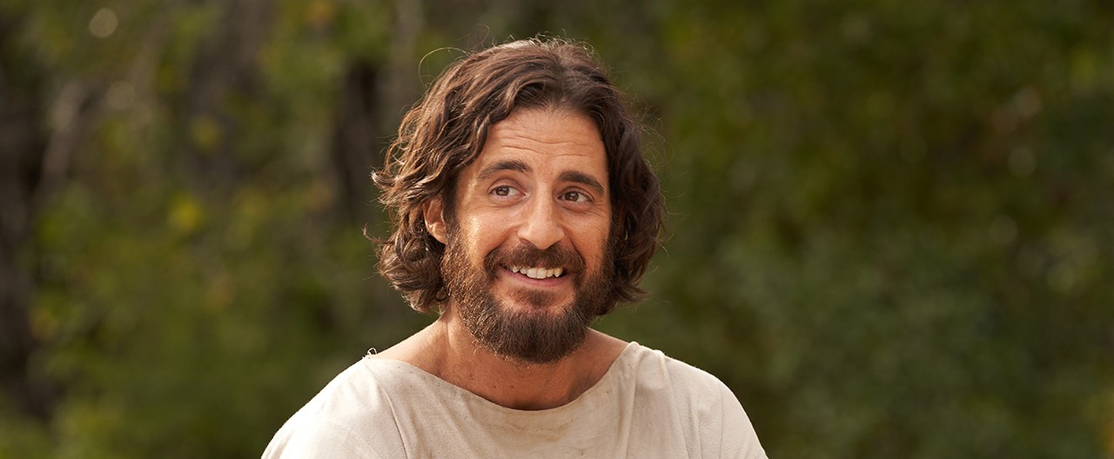
JESUS

Slide 10
EPISODE OVERVIEW

Slide 11
EPISODE OVERVIEW
Mary & Joseph look for 12 year - old Jesus in Jerusalem and find him in the Temple
Mary goes to Cana to help prepare a friend’s son’s wedding
Simon goes home to tell Eden he is following Jesus and leaving his nets behind – she rejoices, then encourages and empowers him. Interesting in 1 Cor 9:5 there is a reference to Peter’s wife travelling with him at least in years after Jesus’ ministry
We see the miracle of water to wine at the wedding feast. They dance to Od Yishama based on Jeremiah 33: 10 – 11 & Song of Miriam Exodus 15:21
We meet Thomas who is puzzled by it all.
Nicodemus does not get answers he is looking for from John the Baptist
Distinction made between private miracles and public signs

Slide 12
TABLE TALK
What specific details stand out for you in this episode? What character impacted you the most? Why? What do you think it would have been like to be one of Jesus’ disciples at this wedding?
In this episode, we are introduced to Mary, Jesus’ mother. How does this episode portray Jesus’ relationship with Jesus? Is this how you imagined their relationship?
How does this episode portray what Jesus was like growing up and what it was like for Mary and Joseph to raise him? What struggles might Mary and Joseph have experienced?
When Simon goes home to tell Eden he is going to leave his nets behind and follow Jesus, she rejoices and encourages him to do so. What do you think of her response? How do you think you would have responded?

Slide 13
TABLE TALK
As the disciples experience Jesus, they exhibit such joy and excitement. Share about a time when you remember feeling especially enthusiastic about Jesus.
In this episode, we see people waiting for Jesus to go public with his ministry. Do you ever feel like you are waiting on God to do something for you? Explain.
The request to make more wine seems somewhat trivial. What can we learn from this story about asking God for help? Do you ask for help in small things? Why or why not?
Jesus reassures Thomas that while it is good to ask questions, we won’t always understand the answers, or even get answers. How do you handle this

