Slide 1
THE CHOSEN EPISODE SIX

Slide 2
OPENING PRAYER

Slide 3
OPENING PRAYER – LUKE 5: 12 - 16
Now there was a man full of leprosy in one of the towns where he was, and when he saw Jesus, he fell prostrate, pleaded with him, and said, “Lord, if you wish, you can make me clean.” Jesus stretched out his hand, touched him, and said, “I do will it. Be made clean.” And the leprosy left him immediately. Then he ordered him not to tell anyone, but “Go, show yourself to the priest and offer for your cleansing what Moses prescribed; that will be proof for them.” The report about him spread all the more, and great crowds assembled to listen to him and to be cured of their ailments, but he would withdraw to deserted places to pray.

Slide 4
OPENING PRAYER - PSALM 103
Bless Yahweh, O my soul. Bless God’s holy name, all that is in me. Bless Yahweh, O my soul, and remember God’s faithfulness in forgiving all your offenses, in healing all your diseases, in redeeming your life from destruction, in crowning you with love and compassion, in filling your years with good things, in renewing your youth like an eagle’s.
Yahweh does justice and always takes the side of the oppressed. God’s ways were revealed to Moses, and Yahweh’s deeds to Israel. Yahweh is merciful and forgiving, slow to anger, rich in love; Yahweh’s wrath does not last forever, it exists a short time only. We are never threatened, never punished as our guilt and our sin deserve.
As the height of heaven over earth is the greatness of Yahweh’ faithful love for those who fear God. Yahweh takes our sin away farther than the east is from the west. As tenderly as parents treat their children, so Yahweh remembers that we are dust. The human lasts no longer than grass, lives no longer than a flower in a field. One gust of wind, and that one is gone, never to be seen there again.
But Yahweh’s faithful love for those who fear God lasts from all eternity and forever, so too God’s justice to their children’s children, as long as they keep the covenant and remember to obey its precepts. Yahweh has established a throne in the heavens and rules over all. Bless Yahweh, O my soul.

Slide 5
THE SIN CYCLE
We follow God’s Plan
We deviate from God’s Plan
We need to be rescued
We repent of our sins
We receive forgiveness
God’s plan is good and loving for our good & God’s glory
We deviate by sinning
We need to be rescued from sin & consequences of our bad choices
We repent from our sin & God willing, able & faithful to forgive us
We receive forgiveness & our relationship with God is restored. We renew our commitment to God & follow God’s plan
We sin again

Slide 6
MEET THE BIBLICAL CHARACTERS

Slide 7
SALOME, MOTHER OF JAMES & JOHN WIFE OF ZEBEDEE
Disciple of Jesus, travelled with him & helped support his ministry
Present at crucifixion, went to tomb & received news of the resurrection by angel & brought news to Apostles
Probably stayed with the disciples after ascension of Jesus waiting for the coming of the Spirit.
Might be sister of Mary, mother of Jesus

Slide 8
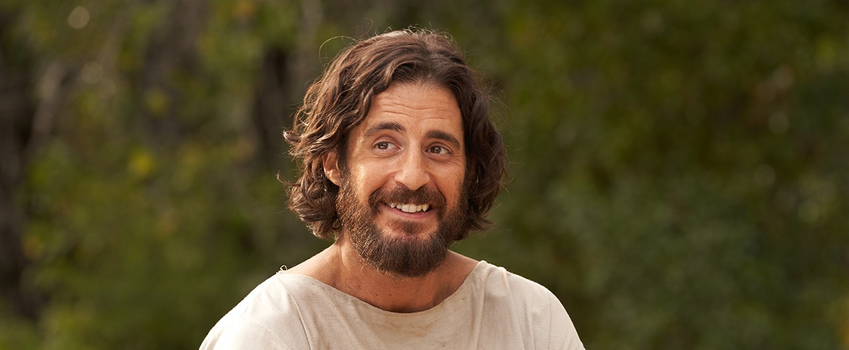
JESUS

Slide 9
EPISODE OVERVIEW

Slide 10
EPISODE OVERVIEW
Jesus heals the leper witnessed by woman Tamar
Jesus goes to Zebedee’s house, crowd gathers and includes, Romans, Matthew, Nicodemus, Pharisees, Abigail & Joshua. Each of these characters, from their different perspectives, experience the healing of the paralytic.
Matthew continues to be puzzled and seeks out Peter & Andrew
Nicodemus seeks to speak to Jesus
The excitement is growing, people are paying attention, Jesus heals people and urges them to be vigilant in faith, followers are growing in numbers and so are his enemies.
Jesus is teaching the people who are gathered there – many parables and familiar teachings

Slide 11
TABLE TALK

Slide 12
TABLE TALK
What characters impacted you this episode? What story line especially caught your attention?
Jesus is teaching his followers while other actions are underway. How many of his parables and teachings were you able to notice? What are they? Which of the teachings / parables impacted you the most? Why?
Leprosy was a disease in the time of Jesus which caused fear. It was a sickness which rendered a person no longer worthy of dignity, love or community. Are there any “like” situations in our world today? How do you think Jesus would respond? How are we called to respond?
How did the disciples’ reaction to the leper differ from Jesus’ reaction? What do you suppose they thought when Jesus touched him? When he healed him?
How would you describe the faith and courage of the leper or the paralytic’s friends? What are examples of such faith today?
In order to take such extreme measures, what must Tamar and the 4 men who carried their friend believed about Jesus? What keeps you from pursuing Jesus with that same kind of passion?

Slide 13
TABLE TALK
How did the healing of the paralytic impact the characters who were present? (Consider some or all: Abigail & Joshua, Matthew, Simon, Mary Magdalen, Nicodemus, Shmuel, Zebedee, Roman soldier, Egyptian woman Tamar and others present) – the paralytic himself?
Can you relate at all to Matthew’s journey at this point? How do you see Matthew processing what he is witnessing?
There is a lot of compassion emphasized in this episode. How did Jesus preach about and show compassion? What are some examples of how we can show the same kind of compassion?
Have you had any kind of experience where you felt healed by Jesus?

Slide 14
TEACHINGS OF JESUS

Slide 15
TEACHINGS OF JESUS
A woman recalls the parable of the fishing net and asks when the day of judgment will come. Jesus replies with the parable of the 10 virgins. (Matthew 25:1 – 13
Jesus asks if people who die in certain disasters were worse sinners than others. Luke 13:1 – 5
Jesus says prayer should be done in private and without impressive-sounding words. Matthew 6:5 – 8
Jesus says that when you give to the needy, you should not let your left hand know what your right hand is doing. Matthew 6:2 – 4
Jesus tells the parable of the Pharisee and the tax collector. Luke 18:9 – 14
Jesus tells the parable of the persistent widow Luke 18:1 – 8
Jesus says God will clothe people just as he clothes the grass that is thrown into the fire Matthew 6:28 – 30 / Luke 12:27 – 28
Jesus says Zebedee would not put his light under a basket Matthew 5:14 – 16 / Luke 8:16, 11:33 - 36

